Slide 1
LORENTZ FORCE
THE force on a charged particle moving through a region containing both electric and magnetic field

Slide 2
Background
The first derivation of the Lorentz force is commonly attributed to Oliver Heaviside in 1889,although other historians suggest an earlier origin in an 1865 paper by James Clerk Maxwell. Hendrik Lorentz derived it a few years after Heaviside.
Origin of Lorentz force
After Hendrik Lorentz

Slide 3

lorentz force

Slide 4

Explanation
The Lorentz force law says the force on a charge moving through a magnetic field is the product of the velocity, charge and magnetic field strength. (There is also a force on the charge due to any electric field it may be in, which the law also includes, but the magnetic induced force is the part most questions about Lorentz force refer to.) The equation says the force due to motion in a magnetic field F = qv X B, where X is the vector cross-product operator. What this means is that F = qvB*sin(theta), where theta is the angle between the directions of v and B. So the maximum force occurs when v is perpendicular to B. F is perpendicular to both v and B, and is in a direction such that if you view v and B while looking in the direction of F, the smallest angle of rotation of qv to B is clockwise. Or if the fingers of your right hand curl in the direction that qv rotates into B, your extended thumb points along F. (These are two ways to visualize the "right-hand rule", which the cross product follows.) Note that the sign of q is a factor in determining the direction of F

Slide 5
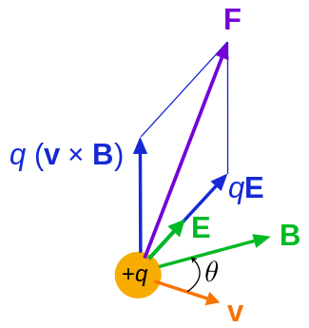
Graphical representation

Slide 6


Lorent force in charged particle
Charged particle[edit]
Lorentz force F on a charged particle (of charge q) in motion (instantaneous velocity v). The Efield and B field vary in space and time.
The force F acting on a particle of electric charge q with instantaneous velocity v, due to an external electric field E and magnetic field B, is given by:^{[3]}
where × is the vector cross product. All boldface quantities are vectors. More explicitly stated:
in which r is the position vector of the charged particle, t is time, and the overdot is a time derivative.
A positively charged particle will be accelerated in the same linear orientation as the E field, but will curve perpendicularly to both the instantaneous velocity vector v and the B field according to the right-hand rule (in detail, if the thumb of the right hand points along v and the index finger along B, then the middle finger points along F).

Slide 7
The term qE is called the electric force, while the term qv × B is called the magnetic force.^{[4]} According to some definitions, the term "Lorentz force" refers specifically to the formula for the magnetic force,^{[5]} with the total electromagnetic force (including the electric force) given some other (nonstandard) name. This article will not follow this nomenclature: In what follows, the term "Lorentz force" will refer only to the expression for the total force.
The magnetic force component of the Lorentz force manifests itself as the force that acts on a current-carrying wire in a magnetic field. In that context, it is also called theLaplace force.

Slide 8
Force in continuous charge distribution
For a continuous charge distribution in motion, the Lorentz force equation becomes:
where dF is the force on a small piece of the charge distribution with charge dq. If both sides of this equation are divided by the volume of this small piece of the charge distribution dV, the result is:
where f is the force density (force per unit volume) and ρ is the charge density (charge per unit volume). Next, the current densitycorresponding to the motion of the charge continuum is
so the continuous analogue to the equation is^{[6]}
The total force is the volume integral over the charge distribution:

Slide 9

Equations

Slide 10
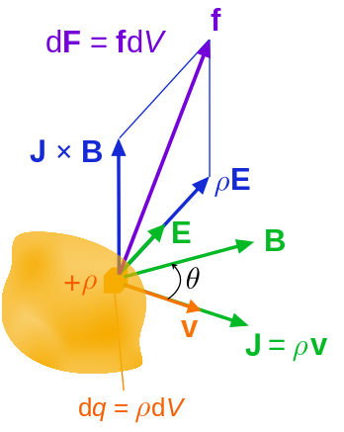
Graphical representation

Slide 11


Trajectories of particles due to the Lorentz force
In many cases of practical interest, the motion in a magnetic field of an electrically charged particle (such as an electron orion in a plasma) can be treated as the superposition of a relatively fast circular motion around a point called the guiding center and a relatively slow drift of this point. The drift speeds may differ for various species depending on their charge states, masses, or temperatures, possibly resulting in electric currents or chemical separation.

Slide 12
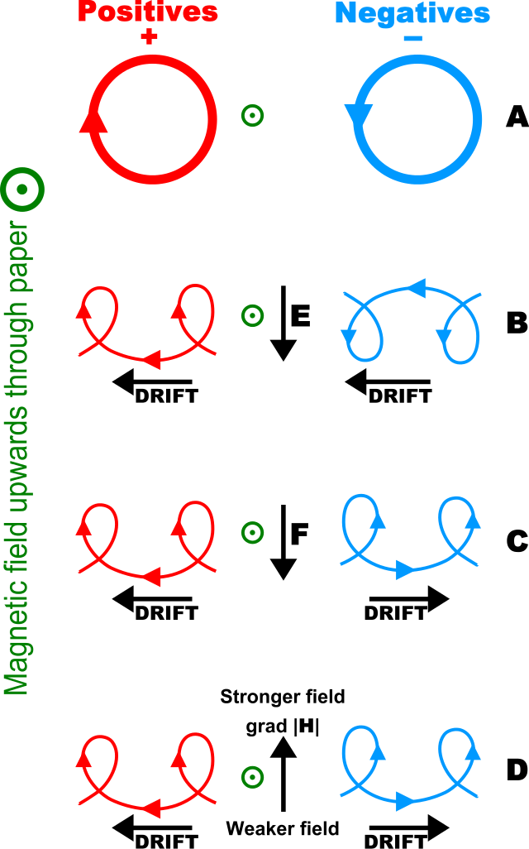
Paths

Slide 13

Significance of lorentz force
The lorentz force describes the effects of electric fieldE and magnetic field B upon a point charge.
But such electromagnetic forces are not a entire picture charged particles are coupled to other forces,notably gravity and nuclear forces
Thus the maxwell’s equation do not seprate from other physical laws but coupled to them via current and charge densties.
The response of a point charge to lorentz law is one aspect, generation of E and magnetic field by current and charge is another.

Slide 14
Force on a current carrying wire
When a wire carrying an electrical current is placed in a magnetic field, each of the moving charges, which comprise the current, experiences the Lorentz force, and together they can create a macroscopic force on the wire (sometimes called the Laplace force

Slide 15
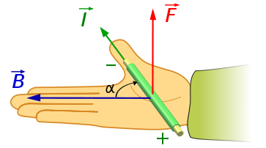
Right hand rule

Slide 16

Equation
One application of this is Ampère's force law, which describes how two current-carrying wires can attract or force from the other's magnetic field. For more information, see the article: Ampère's force law. repel each other, since each experiences a Lorentz

Slide 17
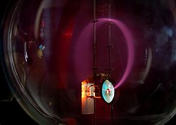
Electron beam movement

Slide 18


Electron beam
Beam of electrons moving in a circle, due to the presence of a magnetic field. Purple light is emitted along the electron path, due to the electrons colliding with gas molecules in the bulb. A Teltron tube is used in this example

Slide 19

Application of lorentz force
LORENTZ force is used in electric motors to convert electrical energy into mechanical energy.
A magnetic field produced by a magnet produces a torque to rotate the current carrying coil if the current flows in the same directio the coil does not rotate continuously, as described before the coil turns in to equilibrium position
IN a real real motor magnet is not a permanent magnet but a pair of coils that form the magnetic field and rotating armature is not asingle coil but a large number of coils.

Slide 20
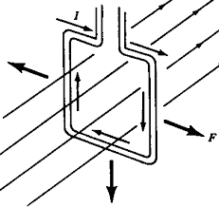
Electric motor

Slide 21

APPLICATIONS
The Lorentz force occurs in many devices, including:
Cyclotrons and other circular path particle accelerators
Mass spectrometers
Velocity Filters
Magnetrons
Lorentz force velocimetry
In its manifestation as the Laplace force on an electric current in a conductor, this force occurs in many devices including:
Electric motors
Railguns
Linear motors
Loudspeakers
Magnetoplasmadynamic thrusters
Electrical generators
Homopolar generators
Linear alternators

Slide 22
APPLICATIONS
Hall effect
Electromagnetism
Gravitomagnetism
Ampère's force law
Hendrik Lorentz
Maxwell's equations
Formulation of Maxwell's equations in special relat

Slide 23

Advantages of lorentz force
LFv is a non-contact techniques of flow rate measurement.
LfV can be successfully applied for such aggressive and high-temperature fluids like liquid metals.
Mean flow rate or mean velocity of fluid can be obtained without depending on flow's inhomogeneities and zones of turbulance.

Slide 24
Limitations
The limitations of the LFV are
Necessity of temperature control of measurement system because of strong dependence of magnet's magnetic field on temperature. High temperature could cause irretrievable loss of the magnetic properties of permanent magnet (Curie temperature).
Restriction of measurement zone by permanent magnet's dimensions.
Necessity of liquid level's control in case of work with open channel.
Rapid decay of the magnetic fields give rise to tiny forces on the magnet system.

Slide 25
Diagnoses of lorentz force
In the late 19th century, Hendrick Lorentz, a Dutch physicist, described what later became known as the Lorentz force. Essentially, a charged particle can be accelerated by moving it through an electric and magnetic field. Today, researchers at MIT are applying the same principle to medical device innovation.

Slide 26
Drug injection without needle
They have developed a device that uses the Lorentz force to inject tiny, high pressure jets of medicine directly through the skin at near sonic speeds. Though it sounds intense, the procedure is purportedly less painful than a traditional needle injection and less invasive, using a nozzle no wider than a mosquito's nose (think how often you feel it when a mosquito bites you).

Slide 27
REFRENCES
Feynman, Richard Phillips; Leighton, Robert B.; Sands, Matthew L. (2006). The Feynman lectures on physics (3 vol.). Pearson / Addison-Wesley. ISBN 0-8053-9047-2.: volume 2.
Griffiths, David J. (1999). Introduction to electrodynamics (3rd ed.). Upper Saddle River, [NJ.]: Prentice-Hall. ISBN 0-13-805326-X.
Jackson, John David (1999). Classical electrodynamics (3rd ed.). New York, [NY.]: Wiley. ISBN 0-471-30932-X.
Serway, Raymond A.; Jewett, John W., Jr. (2004). Physics for scientists and engineers, with modern physics. Belmont, [CA.]: Thomson Brooks/Cole. ISBN 0-534-40846-X.
Srednicki, Mark A. (2007). Quantum field theory. Cambridge, [England] ; New York [NY.]: Cambridge University Press.

Slide 28
Best of luck
Thanks

